Slide 3
Aidan Thompson & Dr Tom Harrison
Jubilee Centre
Virtues, Religion and Character Education: Virtues, Religion and Character Education: How church schools contribute to human flourishing
@CofE_EduLead

Slide 4
Virtues, Religion and Character Education Common Purpose for the Common Good

Slide 5
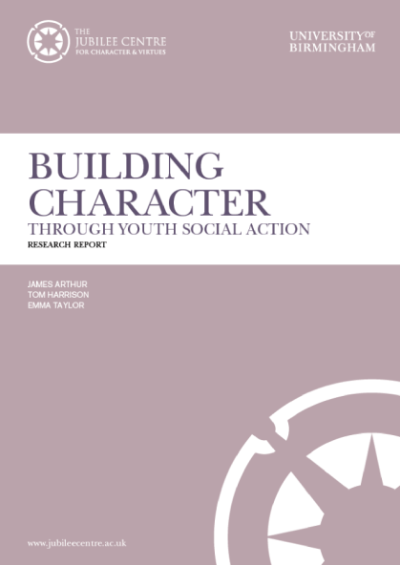
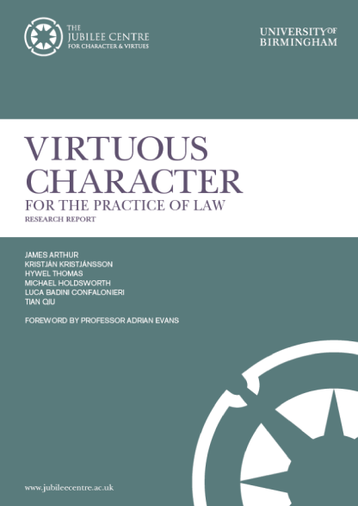
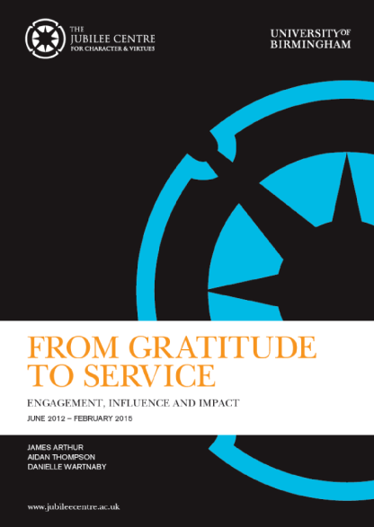
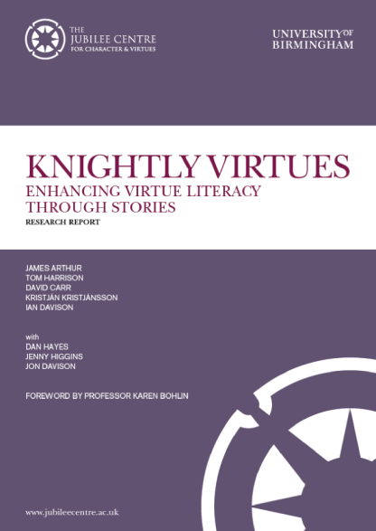
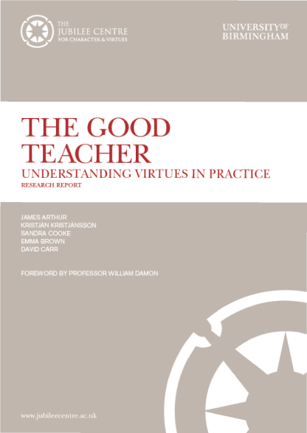
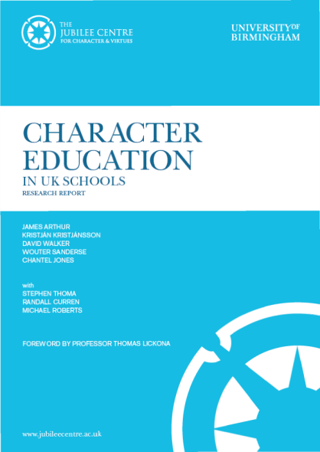
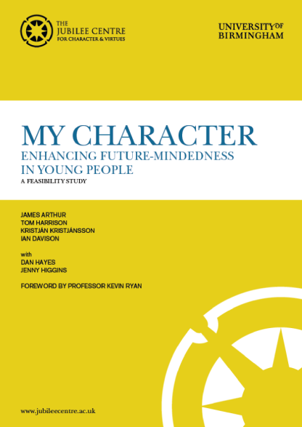
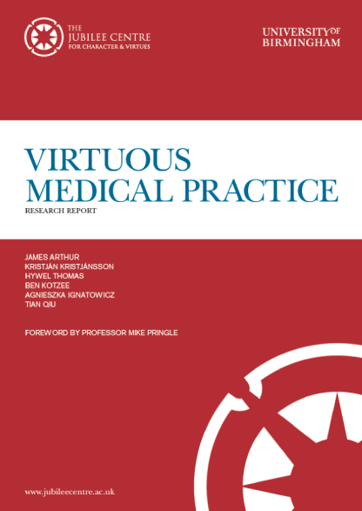
Jubilee Centre : Theory

Slide 6
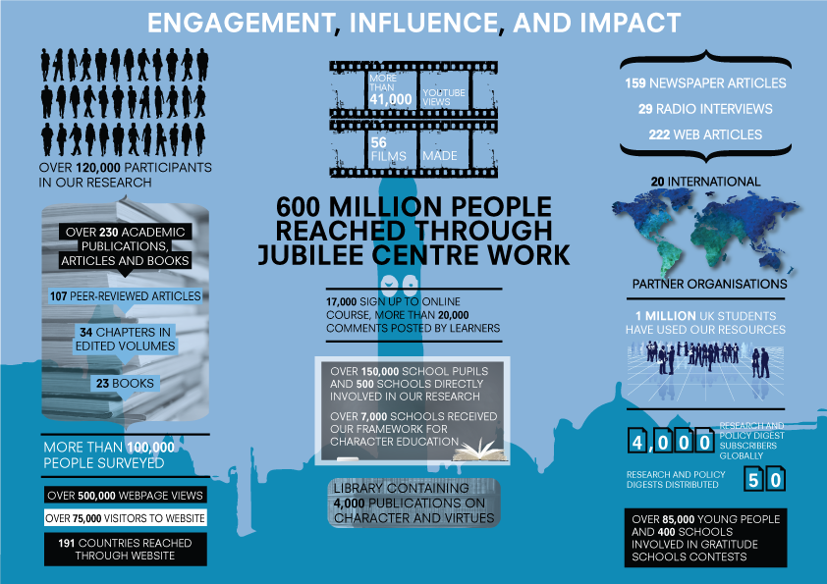
Jubilee Centre : Practice

Slide 7
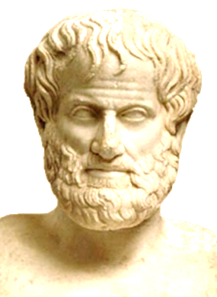
[ ]
Our examination is not a know what virtue is, but to become good
Aristotle

Slide 8
Presentation Overview
Possible starting points
Common ground
Possible differences
Examples in Practice
Some interesting big questions for discussion

Slide 9
Some Possible Starting Points
a) Virtue Ethics
b) Religion
c) Positive Psychology

Slide 10
Common Ground
Focus on flourishing – shared humanity
Common understanding about the purpose of education
Common understanding of the building blocks of character – the virtues
Common pedagogical approaches
Often challenge dominant education policy on similar grounds

Slide 11
Common Ground
‘character traits enable people to live, cooperate and learn with others in a way that is peaceful, neighbourly and morally justifiable. Displaying moral and other virtues in admirable activity over the course of a life, and enjoying the inherent satisfaction that ensues is what it means to live a flourishing life’.
Framework for Character Education, 2013
‘We see the ultimate purpose of education as the promotion of “life in all its fullness.” Education is about more than just producing increasingly efficient economic units: it is about developing people who can flourish in all areas of their lives. Character education is essential to this.’
Fruit of the Spirit, 2015
‘There is no denying the fact that notions of moral character and virtue are a mainstay of all the world’s great religions.’
Kristjánsson, 2013

Slide 12
Character Education : Double Benefit
Human Flourishing: happy, mentally and physically well, successful individuals
+
Societal Flourishing: engaged moral and civically minded citizens

Slide 13
Possible Differences
Underpinning Discipline (e.g. Philosophy, Psychology, Theology)
Priority Virtues
Presence of an overall meta-virtue
Sources of inspiration – underpinning ideology

Slide 14
Possible Differences
‘the idea that ‘character’ and ‘virtue’ do not make sense or cannot be justified outside a religious context is an historical non-starter.’ (Kristjánsson, 2013)

Slide 15
Religion can contribute...
Human beings’ deep-seated orientation or urge – sometimes referred to as ‘a transcendent urge’ – towards extraordinary, idealised experiences of the true, good and beautiful.
This urge is revealed in the inter-human aesthetic impulse and a strong drive towards some sort of spirituality
Character Virtues cannot be neutral – don’t exist in a vacuum.

Slide 16
Virtue Ethics can contribute…
Meta-Virtue of Phronesis
Over-arching ‘moderating’ virtue
Learnt through experience – development of good habits
Useful when virtues conflict
Useful when the rules are not clear or the consequences are hard to calculate

Slide 17
Something Religion and Virtue Ethics can Give Positive Psychology
A greater focus on Moral and Civic virtues
‘a list of prototypical virtues – that will be
recognised and embraced by representatives of all
cultures and religions – can be suggested and
drawn upon in character education. The list contains
examples of such virtues that have been highlighted in
some of the most influential philosophical and religious
systems of morality – and that also resonate well with
current efforts at character education in schools’

Slide 18
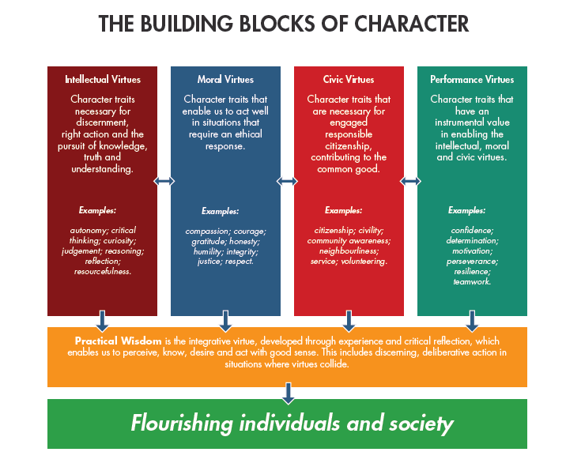

Slide 19
British Virtues
‘actively promoted’ through teaching an appreciation of the rule of law; an understanding of the democratic process; respect for individual freedoms; tolerance of those with different beliefs; and an understanding of how to tackle discrimination’

Slide 20
VIA Virtues

Slide 21
C of E Virtues
The four Cardinal Virtues: Prudence, Temperance, Courage and Justice.
The Seven Heavenly Virtues: Faith, Hope, Charity, Fortitude, Justice, Temperance, Prudence
C of E Vision for Education Document : Wisdom, Hope, Community and Dignity

Slide 22
Unity of the Virtues
‘Might there be an argument for defining “good
character” not as a list of traits but as something
embedded in a deep vision about the place of
human beings in the world?’
Fruit of the Spirit, 2015

Slide 23
Universal Virtues?
Acknowledgement and development of moral character posits the existence of certain ‘common/universal virtues’ which extend across cultural boundaries. Integration of this philosophy into the teaching of British values could help to enhance delivery and ultimately social cohesion.
Encouraging discussion and reflection in the classroom and schools more broadly can help teachers and students to consider how universal virtues such as compassion, gratitude and honesty can inform discussions around citizenship and provide a more inclusive teaching environment.

Slide 24
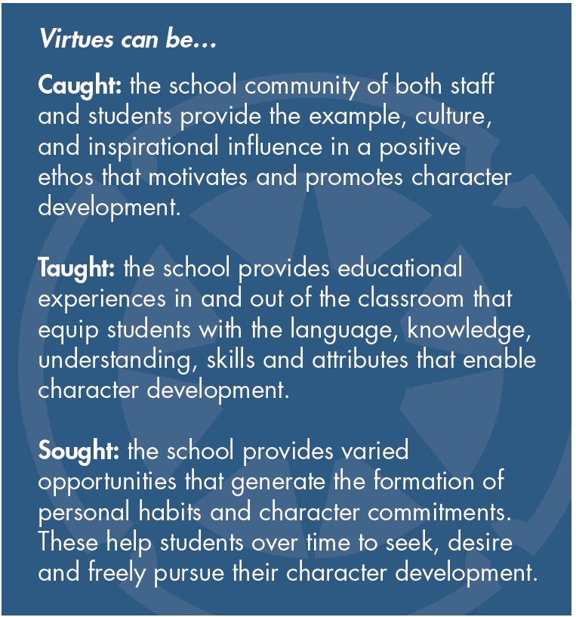

Slide 25
Example 1 : Virtue Literacy
Knightly Virtues Programme Findings: 
Significantly increases pupils’ ability to apply
virtue language and concepts in personal
contexts 

Closes the gap between pupils in faith and non
faith schools in their grasp of virtue language
and concepts in personal contexts

Slide 26
Example 2 : Virtue, Vice and Verse

Slide 27
Example 3 : Youth Social Action
Real-life opportunities to contribute to the common good and build character
Linked to an organisation – school, church, charity
Building virtues through youth social action
Habits of Service

Slide 28
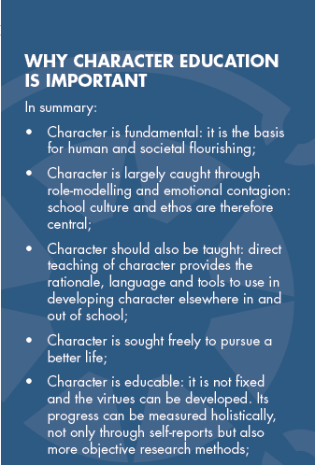
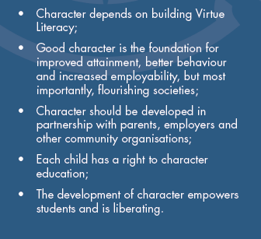

Slide 29
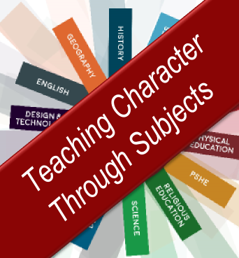
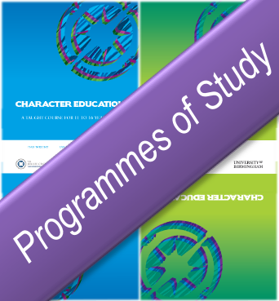
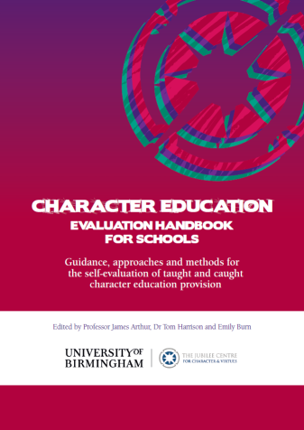
Jubilee Centre Resources and Programmes

Slide 30
Big Questions for Discussion
What might a particularly Christian approach to character education look like?
Is there a tension between more secular and more religious notions of character education?
Are there universal virtues?
Can you have common teaching with some accepting it as Christian while others accepting it as in some way secular?

